Slide 1
Lecture No. 23 Fuels
At the end of this lecture, students will be able to:
Explain the significance of calorific value of fuel
Discuss the process for the determination of calorific value of given solid or liquid fuel using Bomb’s calorimeter
Solve simple problems related to calorific value of fuels
Describe the various steps involved in refining process of petroleum

Slide 2
Calorific value
Calorific value is defined as the total quantity of heat liberated by complete combustion of unit mass(or volume) of the fuel
Higher the calorific value, more efficient is the fuel
The calorific value is expressed in J/kg or kJ/kg for solid and liquid fuels and J/m³ or kJ/m³ for gaseous fuels in SI units
Calorific value can be classified into two types
Gross Calorific Value (Higher Calorific Value)
Net calorific value (Low Calorific Value)

Slide 3
Gross/higher calorific value:
Amount of heat liberated when a unit quantity (1 kg or 1 m³ ) of a fuel is completely burnt in air or oxygen and the products of combustion are cooled to room temperature
Definition of net/low calorific value:
Amount of heat released when unit quantity of a fuel is completely burnt in air or oxygen and the products of combustion are let off into the atmosphere
Relation ship between GCV and NCV
GCV= NCV+ Heat associated with steam (Latent heat)

Slide 4
Determination of calorific value of a solid fuel using Bomb Calorimeter
Principle:
Heat liberated during the combustion of known weight of fuel is equal to the heat absorbed by water and copper calorimeter
Gross calorific value of the fuel is determined by measuring the temperatures before (T₁) and after (T₂) combustion of the fuel

Slide 5
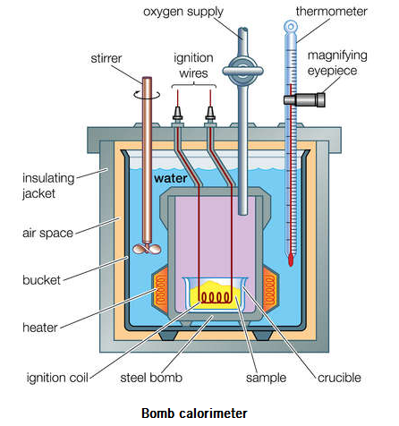
Bomb Calorimeter

Slide 6
Determination of Calorific Value
Observation and calculations:
Gross calorific value = J kg⁻¹
Where w = w₁ + w₂
= mass of water in the calorimeter, in kg + water equivalent of the calorimeter, in kg
s = specific heat of water, in J kg^{-1 o}C⁻¹
Δt = t₂-t₁ = rise in temperature, in ºC
m = mass of the fuel, in kg
$$\frac{{(W}_{1}+W_{2}) s ∆t }{m}$$

Slide 7
Determination of Calorific Value
(Note: If the mass of fuel is given in grams, convert that into kg. For example, 0.2 g = 0.2 × 10⁻³ kg. If specific heat of water is given in J kg⁻¹ °C⁻¹, calorific value will be in J kg⁻¹. If the specific heat is given in kJ kg⁻¹ °C⁻¹, then the calorific value will be in kJ kg⁻¹.)
(Note: Specific heat of water is the amount of heat energy required to increase the temperature of one kg of water by one degree C.)
1. Calculate the gross and net calorific values of a coal sample from the following data obtained in a Bomb calorimetric experiment. (i) Weight of coal= 0.85g (ii) Weight of water taken in calorimeter= 2.35kg
(iii) Water equivalent of calorimeter = 0.45kg (iv) Latent heat of steam= 2457kJ/kg
(v)Percentage of hydrogen =2.5% (vi) Rise in temp= 3.20°C
(vii) Specific heat of water= 4.187kJ/kg/°C

Slide 8
Determination of Calorific Value
2. Calculate the gross and net calorific values of a coal sample from the following data obtained in a Bomb calorimetric experiment.
(i) Weight of coal= 0.98g (ii) Weight of water taken in calorimeter= 2600g
(iii) Water equivalent of calorimeter= 368g (iv) Latent heat of steam= 2454kJ/kg
(v)Percentage of hydrogen =5.8% (vi) Rise in temp= 2.80°C
(vii) Specific heat of water= 4.187kJ/kg/°C

Slide 9
Determination of Calorific Value
3. Calculate the gross and net calorific values of a coal sample from the following data obtained in a Bomb calorimetric experiment.
(i) Weight of coal= 0.65kg (ii) Weight of water taken in calorimeter= 1200kg
(iii) Water equivalent of calorimeter= 400kg (iv) Latent heat of steam= 587 x 4.2kJ/kg
(v)Percentage of hydrogen =2% (vi) Rise in temp= 1.80°C
(vii) Specific heat of water= 4.187kj/kg/°C

Slide 10
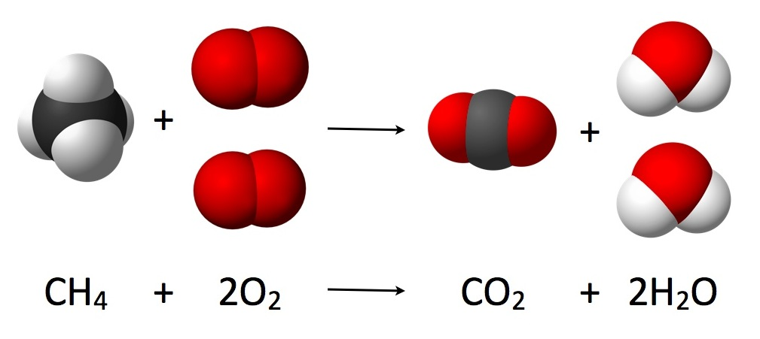
Stoichiometric Combustion
Stoichiometric or Theoretical Combustion is the ideal combustion process where fuel is burned completely
Ex:
1 g mol of methane consumes 2 mol of oxygen for complete combustion

Slide 11
Stoichiometric Combustion
A complete combustion is a process of burning all the carbon (C) to (CO₂), all the hydrogen (H) to (H₂O) and all the sulphur (S) to (SO₂)
With unburned components in the exhaust gas, such as C, H₂, CO, the combustion process is uncompleted and not stoichiometric
Combustion process can be expressed as:
[C + H (fuel)] + [O₂ + N₂ (Air)] → (Combustion Process) →
[CO₂ + H₂O + N₂ + Heat]
Stoichiometric ratio is the perfect ideal fuel ratio where the chemical mixing proportion is correct
When burned all fuel and air is consumed without any excess left over

Slide 12
Stoichiometric Combustion
If an insufficient amount of air is supplied to the burner, unburned fuel, soot, smoke, and carbon monoxide exhausts from the boiler - resulting in heat transfer surface fouling, pollution, lower combustion efficiency, flame instability and a potential for explosion
If air content is higher than the stoichiometric ratio - the mixture is said to be fuel-lean
If air content is less than the stoichiometric ratio - the mixture is fuel-rich
In case of IC engines, generally air: fuel ratio used is 14.7 : 1

Slide 13
Stoichiometric Combustion
Ex: Stoichiometric Combustion of Methane - CH₄
Most common oxidizer is air
Chemical equation for stoichiometric combustion of methane - CH₄ - with air can be expressed as
CH₄ + 2(O₂ + 3.76 N₂) → CO₂ + 2 H₂O + 7.52 N₂
If more air is supplied, some of the air will not be involved in the reaction

Slide 14
Stoichiometric Combustion
Additional air is termed excess air, but the term theoretical air may also be used, 200% theoretical air is 100% excess air
Chemical equation for methane burned with 25% excess air can be expressed as
CH₄ + 1.25 x 2(O₂ + 3.76 N₂) → CO₂ + 2 H₂O + 0.5 O₂ + 9.4 N₂

Slide 15
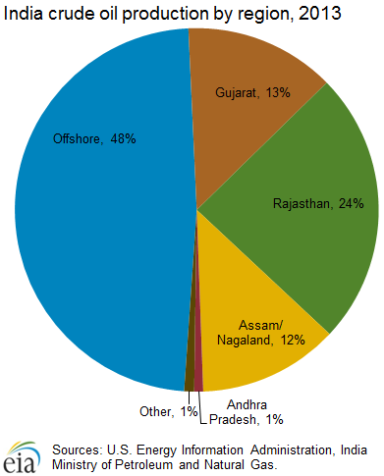
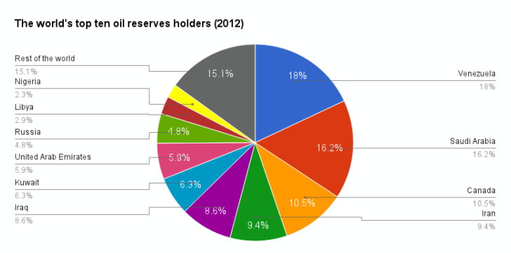
Refining
Petroleum refining
Crude oil from the field is a mix of hydrocarbons of different molecular length (all hydrocarbons contain carbon and hydrogen, but in different compositions)
Refining is the process through which the various components of crude oil are separated

Slide 16
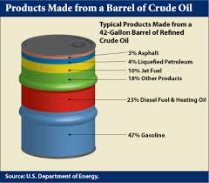
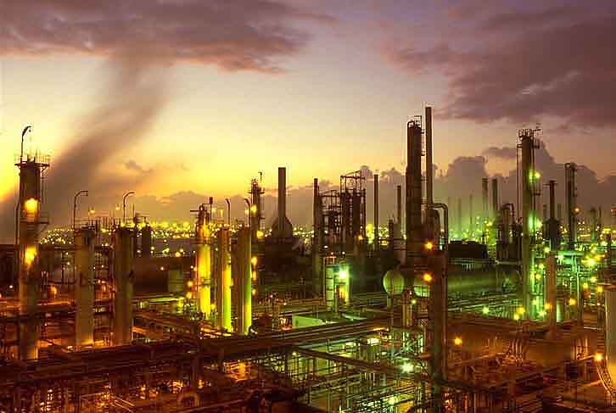
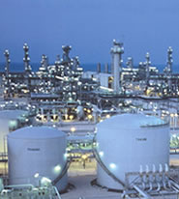
What is a refinery?
Vacuum distillation
Cracking: thermal or catalytical, etc.
The objective is to increase the output of light products, which are more valuable and reduce residuals, which constitute a problem

Slide 17
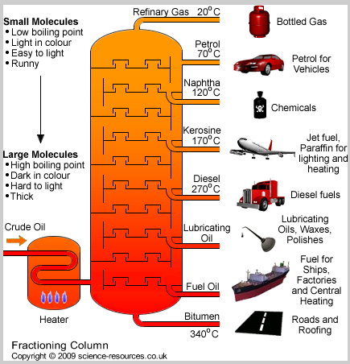
Petroleum Refining Process……
Simple Distillation Process – straight run

Slide 18
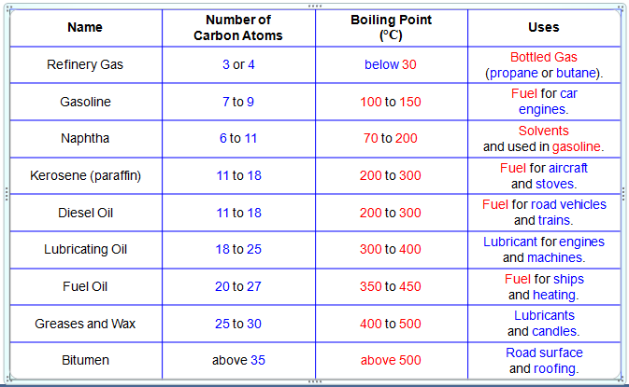
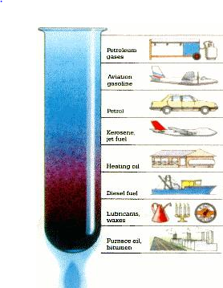
Fractions of Crude Oil

Slide 19
Summary
Significance of calorific value of fuel – high CV – higher is the efficiency of the fuel
Determination of calorific value of given solid or liquid fuel using Bomb’s calorimeter – GCV and NCV are the two parameters that can be found by this method
Simple problems related to GCV and NCV of fuels
Refining process of petroleum – gas, petrol, diesel, naphtha, kerosene, etc.

